Slide 1
0 | 0 | 0 | 0 | 0
0 | 0 | 0 | 0 | 0
0 | 0 | 1 | 0 | 0
0 | 0 | 0 | 0 | 0
0 | 0 | 0 | 0 | 0
Notes:
initial_A_concentration

Slide 2
0 | 0 | 0 | 0 | 0
0 | .05 | .2 | .05 | 0
0 | .2 | 0 | .2 | 0
0 | .05 | .2 | .05 | 0
0 | 0 | 0 | 0 | 0
Notes:
A_concentration_one_time_step

Slide 3
? | ? | ? | ? | ?
? | .08 | .04 | .08 | ?
? | .04 | .17 | .04 | ?
? | .08 | .04 | .08 | ?
? | ? | ? | ? | ?
Notes:
A_concentration_two_time_steps_partial

Slide 4
.0025 | .02 | .045 | .02 | .0025
.02 | .08 | .04 | .08 | .02
.045 | .04 | .17 | .04 | .045
.02 | .08 | .04 | .08 | .02
.0025 | .02 | .045 | .02 | .0025
Notes:
A_concentration_two_time_steps_complete

Slide 5
0 | 0 | 0 | 0 | 0
0 | .01 | .04 | .01 | 0
0 | .04 | .8 | .04 | 0
0 | .01 | .04 | .01 | 0
0 | 0 | 0 | 0 | 0
Notes:
A_concentration_slower_diffusion

Slide 6
0, 0 | 0, 0 | 0, 0 | 0, 0 | 0, 0
0, 0 | 0, 0 | 0, 0 | 0, 0 | 0, 0
0, 0 | 0, 0 | 1,1 | 0, 0 | 0, 0
0, 0 | 0, 0 | 0, 0 | 0, 0 | 0, 0
0, 0 | 0, 0 | 0, 0 | 0, 0 | 0, 0

Slide 7
0, 0 | 0, 0 | 0, 0 | 0, 0 | 0, 0
0, 0 | .01, .005 | .04,.02 | .01, .005 | 0, 0
0, 0 | .04,.02 | .8, .9 | .04,.02 | 0, 0
0, 0 | .01, .005 | .04,.02 | .01, .005 | 0, 0
0, 0 | 0, 0 | 0, 0 | 0, 0 | 0, 0
Notes:
two_particle_concentration_diffusion

Slide 8
X
Y
Z
Notes:
feed-forward_loop

Slide 9
+
+
−
X
Y
Z
Notes:
type-1_incoherent_feed-forward_loop

Slide 10
−
X
Y
−
−
Z
Notes:
repressilator

Slide 11
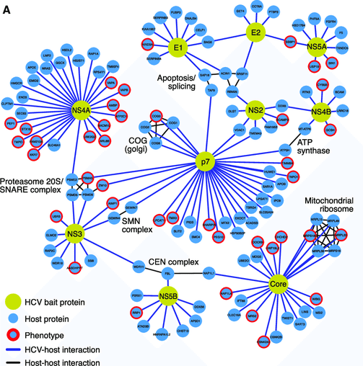

Slide 12
L
3) Response: changed rotation direction
1) Stimulus: ligand
L
L
L
L
Extracellular Space
Receptor
Cellular membrane
Chesson P.. Mechanisms of maintenance of species diversity. Annu Rev Ecol Evol Syst 31: 343-366 https://journals.plos.org/ploscompbiol/article?id=10.1371/journal.pcbi.1008010
Cytoplasm
CW rotation
2) Signaling Events

Slide 13
L
L
L
L
L
Receptor
Chesson P.. Mechanisms of maintenance of species diversity. Annu Rev Ecol Evol Syst 31: 343-366 https://journals.plos.org/ploscompbiol/article?id=10.1371/journal.pcbi.1008010

Slide 14
1) Stimulus: ligand
L
3) Response: changed rotation direction
L
L
Extracellular Space
MCP
Cellular membrane
Chesson P.. Mechanisms of maintenance of species diversity. Annu Rev Ecol Evol Syst 31: 343-366 https://journals.plos.org/ploscompbiol/article?id=10.1371/journal.pcbi.1008010
Cytoplasm
CW rotation
CheW
P
CheA
P
CheY
CheZ
ATP
ADP
CheY
P
2) Signaling Events

Slide 15
L
L
L
Extracellular Space
MCP
Cellular membrane
Chesson P.. Mechanisms of maintenance of species diversity. Annu Rev Ecol Evol Syst 31: 343-366 https://journals.plos.org/ploscompbiol/article?id=10.1371/journal.pcbi.1008010
Cytoplasm
+CH₃
CheR
CheW
-CH₃
P
CheA
P
CheB
ATP
ADP
P
CheB

Slide 16
L
Stimulus: ligand
L
Response
L
Extracellular Space
MCP
Cellular membrane
+CH₃
Cytoplasm
CheR
CheW
CW rotation
-CH₃
P
CheA
P
P
CheY
CheB
CheZ
ATP
ADP
P
CheB
CheY
P
Adaptation
Initially: Feed-forward

Slide 17
Notes:
two_shapes

Slide 18
(-1, 0)
(1, 0)
Notes:
semicircular_arc

Slide 19
1
5
4
2
3
6
8
9
7

Slide 20
1
5
4
2
3
6
8
9
7

Slide 21
1
2
3
5
4
6
8
9
7

Slide 22
1
2
3
5
4
6
8
9
7

Slide 23
1
1
5
4
2
6
2
3
3
8
9
5
4
7
6
8
9
7

Slide 24
1
2
3
1
5
4
5
4
2
3
6
8
6
8
9
7
9
7
1
1
5
4
2
6
2
3
3
8
9
5
4
7
6
8
9
7

Slide 25
1
2
3
1
5
4
5
6
4
2
3
8
6
8
9
7
9
7
1
1
5
1
4
2
6
1
5
2
3
3
8
2
3
4
9
5
5
6
7
2
3
8
4
4
6
9
6
8
8
7
9
9
7
7
Notes:
RMSD_weaknesses_mutation

Slide 26
1
2
3
4
5
6
7
8
9
5
6
4
1
2
3
7
8
9
Notes:
RMSD_weakness_loop

Slide 27
(4, 6)
3
4
(5, 6)
(2, 5)
2
4
(6, 5)
2
3
(2, 4)
(4, 4)
(1, 3)
1
1
(2, 2)
Notes:
rmsd_simple_shapes

Slide 29
1
4
2
3
Notes:
circle_square_undersampling

Slide 30
Notes:
knn_neighborhood

Slide 31
Notes:
knn_neighborhood_k=1

Slide 32
Notes:
knn_neighborhood_k=4

Slide 33
Notes:
three_similar_shapes_unaligned

Slide 34
Notes:
three_similar_shapes_aligned

Slide 35
Notes:
inscribed_circle

Slide 36
Notes:
inscribed_sphere

Slide 37
Notes:
inscribed_circle_and_sphere

Slide 40
Notes:
residuals_y_coordinates

Slide 41
Notes:
residuals_x_coordinates

Slide 42
Notes:
residuals_projections

Slide 43
Test condition
Positive
Negative
True Positive | False Negative
False Positive | True Negative
Positive
Actual condition
Negative
Notes:
medical_test_confusion_matrix

Slide 44
Test condition
Positive
Negative
1,000 | 500
2,000 | 198,000
Positive
Actual condition
Negative
Notes:
medical_test_confusion_matrix_hypothetical

